Slide 1
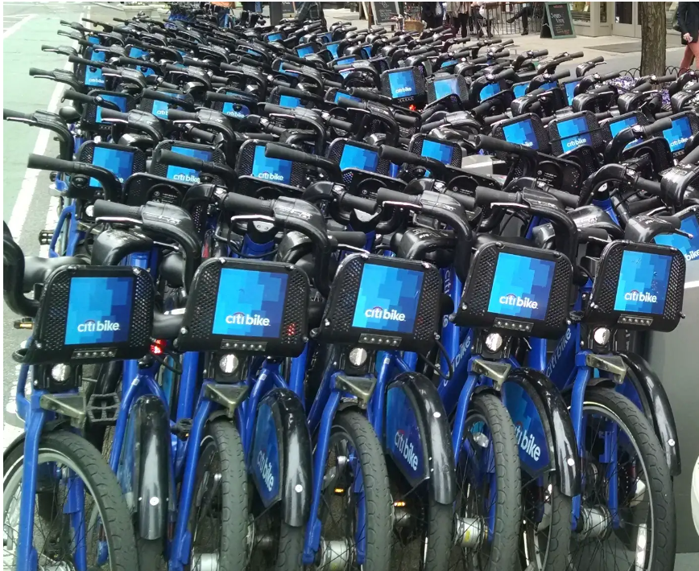
A New Hint to Transportation-Analysis of NYC bike share system
Team Members:
Faculty Mentor:
Ajmal Baiju-963319104009
Ebin P John-963319104024
Hebrone Edison-963319104026
Jackson Antony-963319104027
Riju Paul-963319104050
AP/Mrs.R.ANUJA

Slide 2
ABSTRACT
Bike-sharing systems have been deployed in many major cities around the world today. Bike sharing systems provide great advantages as a mean of urban public transportation facilitating a green solution for daily commuters and tourists.
Users tend to use more often this type of transportation for their daily needs. The key to success for such systems is the efficient distribution of bikes among the bike stations in order to satisfy high user demands.
Existing schemes in the literature focus either on predicting the bike station demand and modeling user mobility mainly focusing on making cycling more accessible to people, or on minimizing the costly and time-consuming movement of bikes among the stations while the system is in use. In this work our objective is to gain insights into the usage of bike sharing systems and in particular the pick-up and drop-off operations.
Our goal is to get a better understanding of the bike mobility patterns and identify the key factors that lead to imbalances in the distribution of the bikes at the stations, towards creating effective and sustainable bike sharing systems. One of the problems in bicycle sharing systems design is the estimation of the potential demand to the service, especially in countries where this type of systems is not yet implemented.
The main objective of this methodology is to relate the demand of bike-sharing systems with external characteristics that affects the bicycle usage in order to obtain its territorial distribution.

Slide 3
LITERATURE SURVEY
TITLE:BIKE SHARE SYSTEM AUTHOR : ELLIOT FISHMAN
Bikeshare has grown rapidly in the past decade. Although the concept has been around since the 1960s, the number of cities offering bikeshare has increased from just a handful in the late 1990s to over 800 at the time of publication (Meddin & DeMaio, 2015). Contemporary bikeshare programmes (BSPs) refer to the provision of bikes, which can be picked up and dropped off at self-serving docking stations. Typically, trips are of a short duration (less than 30 min).
The bicycles usually contain technologies that allow the programme operator to track their docking station location and some are equipped with a global positioning system (GPS) (Davis, 2014). Payment is usually by credit card, and this also acts as a form of security and eliminates the anonymity that led to the demise of earlier, less technologically advanced BSPs (DeMaio, 2009; Shaheen, Guzman, & Zhang, 2010).

Slide 4
LITERATURE SURVEY
TITLE : History and Recent Growth AUTHOR: E FISHMAN
In 1965 Witte Fietsen (White Bikes) was launched in Amsterdam (Davis, 2014). This programme consisted of white painted bicycles on the street, free for people to use. The total absence of security mechanisms led to theft and vandalism, and a rapid demise of Witte Fietsen (DeMaio, 2009). Bikeshare, as a concept, experienced little growth after the failure of the White Bike programme, until technological advancements emerged designed to reduce the threat of vandalism and theft.Some researchers have categorised the evolution of bikeshare systems into four ‘generations’ (Parkes, Marsden, Shaheen, & Cohen, 2013). The White Bike programme described above is known as a first-generation bikeshare ‘system’, characterised by no payment or security functions. Second-generation programmes involved a coin deposit system (similar to trolleys at a supermarket or airport). The first large-scale second-generation programme launched in Copenhagen in 1995, but the anonymity exposed the system to theft (DeMaio, 2009). The problems experienced by these first two generations of bikeshare led to the development of third-generation systems, which are characterised by dedicated docking stations (in which bicycles are picked up and returned), as well as automated credit card payment and other technologies to allow the tracking of the bicycles (Shaheen , Cohen, & Martin, 2013).

Slide 5
LITERATURE SURVEY
TITLE: Generations of Bike Share AUTHOR: Davis, L. S
Some researchers have categorised the evolution of bikeshare systems into four ‘generations’ (Parkes, Marsden, Shaheen, & Cohen, 2013). The White Bike programme described above is known as a ‘firstgeneration bikeshare system’, characterised by no payment or security functions. Second-generation programmes involved a coin deposit system (similar to trolleys at a supermarket or airport). The first largescale second-generation programme launched in Copenhagen in 1995, but the anonymity exposed the system to theft (DeMaio, 2009). The problems experienced by these first two generations of bikeshare led to the development of third-generation systems, which are characterised by dedicated docking stations (in which bicycles are picked up and returned), as well as automated credit card payment and other technologies to allow the tracking of the bicycles (Shaheen, Cohen, & Martin, 2013). It is these elements, in combination with growing public policy interest in cycling (Pucher & Buehler, 2012), that have enabled the rapid growth of BSPs globally (Shaheen & Guzman, 2011). The features of fourth-generation systems are not quite so clear, but are said to potentially include dockless systems, easier installation, power assistance and transit smartcard integration.

Slide 6
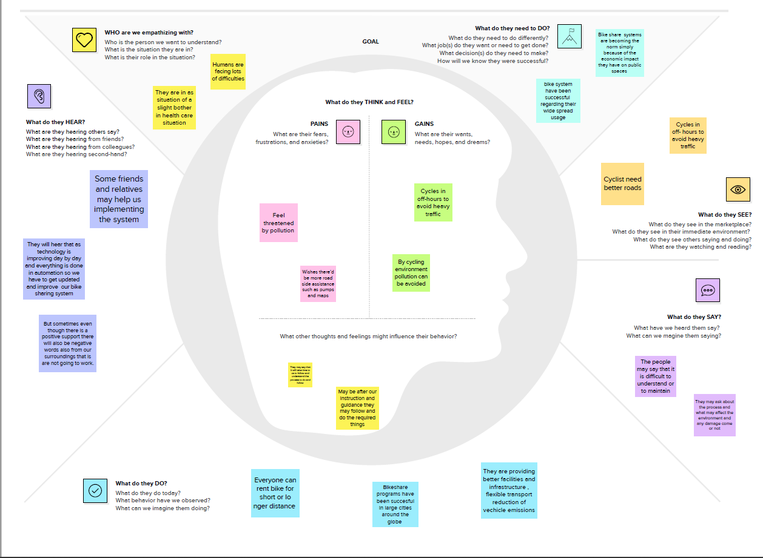
EMPATHY MAP

Slide 7
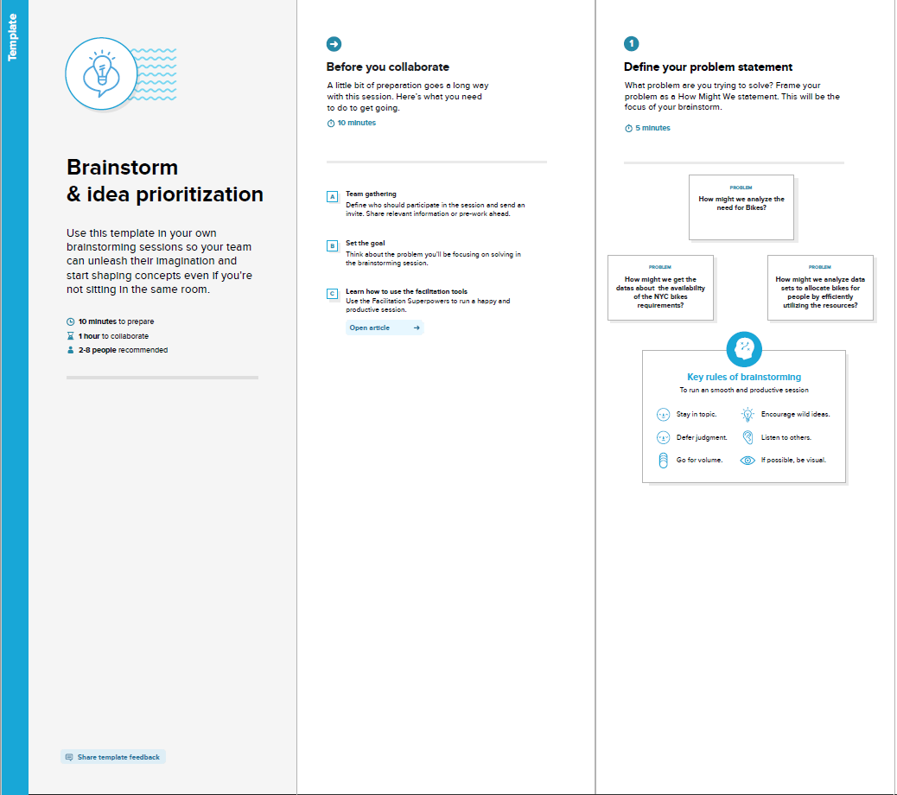
BRAINSTORMING

Slide 8
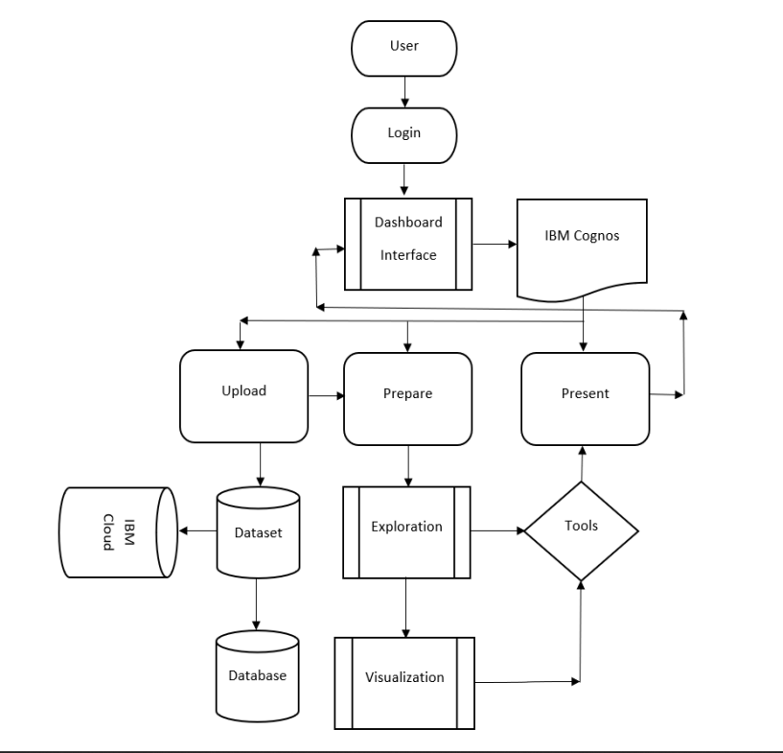
DATA FLOW DIAGRAM

Slide 9
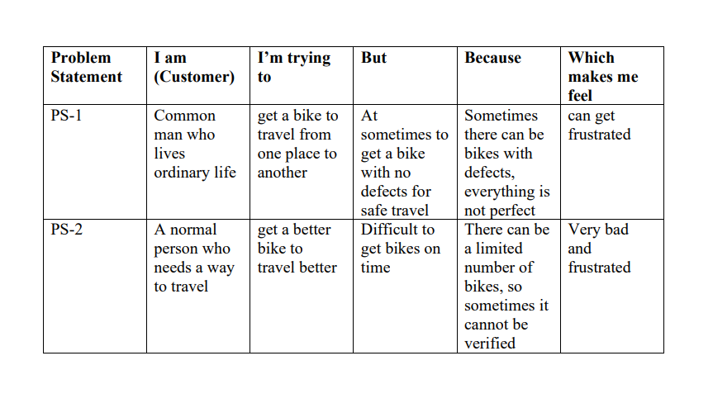
IDEATION PHASE

Slide 10
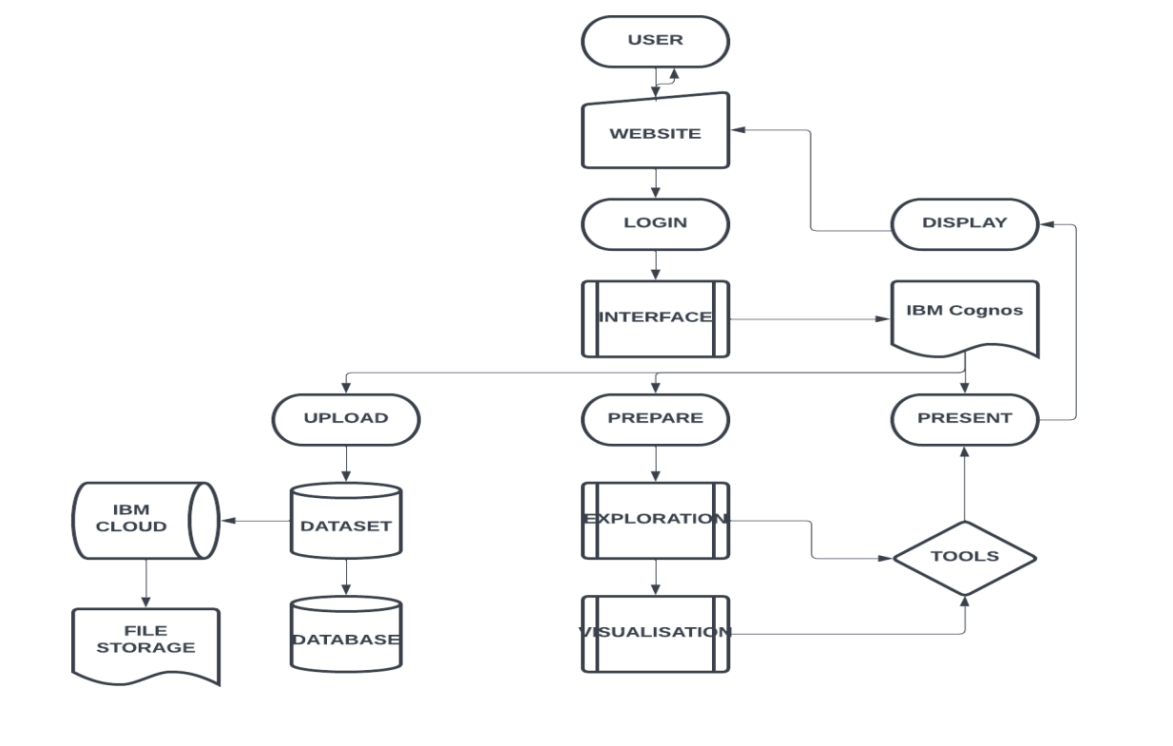
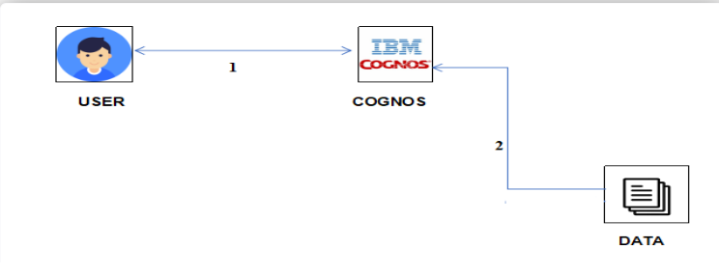
ARCHITECTURAL DIAGRAM

Slide 11
CONCLUSION
The Citi Bike trip data, while useful for analysis as provided, can be made more so with some data preparation with more or less details .
The Citi bike NYC data can be loaded and analysed successfully.

Slide 12
THANK YOU

